Slide 1
Sounding the Alarm with IAM

Slide 2

IAM
Simple User and Access Management

Slide 3

Overview
Users? Policies? Groups?
Security is the best policy

Slide 4
Identity & Access Management Overview

Slide 5
Identity & Access Management (IAM)
Service to configure authentication and access for user accounts

Slide 6
IAM User Management Aspects
Passwords
Multi-factor Authentication
Access Keys
SSH Keys

Slide 7
IAM Policy
Policy
Permission
Resource Permission
Service Permission

Slide 8
IAM Policy Examples
Developer Group Policy
Tester Group Policy
DynamoDB Read-only
EC2 Full Access
S3 Full Access Test Bucket

Slide 9
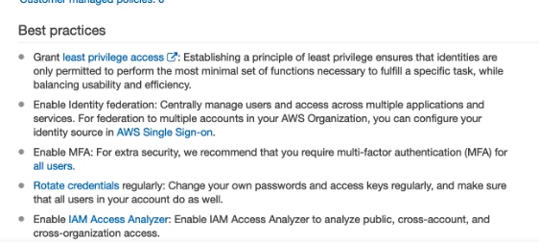

Slide 10
“I use IAM for all my AWS security needs.”
- A Very Cooperative Developer Co-worker

Slide 11
Securing Your AWS Account

Slide 12
Protect your AWS Account

Slide 13
Administer all services
Modify billing information Manage users
Root Account Permissions

Slide 14
Multi-factor Authentication
Authentication that requires more than one factor to authenticate

Slide 15
MFA with AWS
“Know” a Password
“Have” a Device

Slide 16


MFA Process
1. Enter Username and Password
2. Enter MFA Authentication Code
634

Slide 17


MFA Devices
Hardware
Virtual (Smartphone)

Slide 18
Download an MFA App

Slide 19
Demo
Setup MFA on your root AWS account

Slide 20

Demo hidden for security reasons

Slide 21
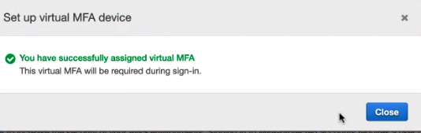

Slide 23
MFA increases the security of your AWS account

Slide 24
Understanding Policies

Slide 25
Users have no permissions by default

Slide 26
Policy Statement Properties
Action
Eﬀect
Resource
Operation user can perform on services
“Allow” or “Deny”
Specific resources user can perform action on

Slide 27
IAM Policy Types
AWS Managed Policy
Customer Managed Policy
General Purpose
Service-wide Permissions
Custom Specific Resource
Permissions

Slide 28
Use policies to give permissions

Slide 29
Configuring Users and Groups

Slide 30

IAM Users
Permissions via Policies
Authentication (Password, MFA)

Slide 31

IAM Groups
Permissions via Policies

Slide 32
Demo
Create a new user
First, install the CLI from the below link:-
https://docs.aws.amazon.com/cli/latest/userguide/getting-started-install.html

Slide 33
Demo
Create a new group

Slide 34
Demo
Create a password policy

Slide 35
Demo
Assign a password to our user

Slide 36
Conclusion

Slide 37
Summary
IAM security lockdown
Don’t mess with root access

